Slide 1
Through these steps we need to identifiy where all customer will be
communicated by phone, email/sms confirmations
Applicant to make entry and upload the required docs(except the photograph): Guidance note, call back facility etc. will be given to assist the applicant for smooth process
by calling the applicant (call back facility)
Customer Care(CC) executive verifies the data entered with uploaded docs: If required, CC executive make necessary correction in the entries, preferences etc.
by calling the applicant (Ok)
CC executive takes appointment and do the IPV thru webcam
by calling the applicant (OK)
Make the completed application available in downloadable format to the applicant OR courier the printed one( as per the choice)
informs by email & calling the applicant(Ok)
Applicant takes print out, paste photo, signs at required places and send back to CC along with attested supporting docs
remind by mail/sms & by calling the applicant . Will this postage be paid by Geojit(ok,yes)
CC confirms the receipt of the application to the applicant
inform by mail /sms & by calling the applicant .(ok)
CR Dept. process the application and ACTIVATE the account.
Inform by mail/sms & by calling the applicant .(ok)

Slide 2
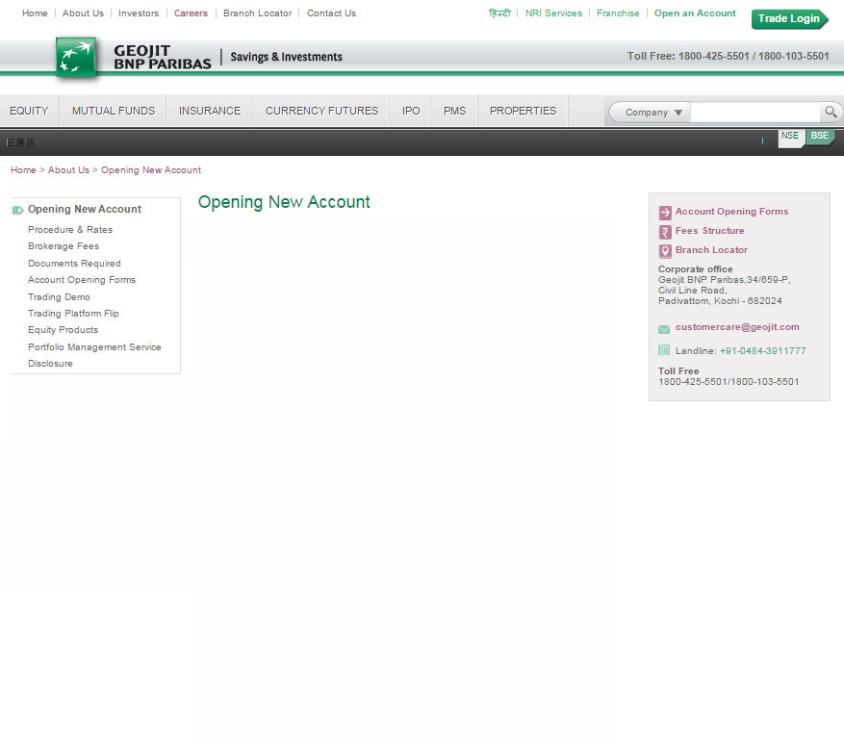
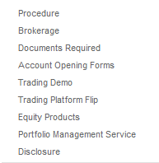


Geojit Online Account Opening
STEP 1
Resume account creation
Revalidate with mobile OTP
Are you a
Resident Indian
NRI Sub-category options
Non Resident Indian
Select Sub-category
NRI
PIO
OCI
NEXT
If Selection is Foreign National: Need to show the message
“Foreign Nationals (Eligible) are allowed to invest in Indian Market only under Foreign Portfolio Investors (FPI) route.”
If selection is US Persons: Need to show the message
“This service is not available for US persons” and stops the user to move further
On selection NRI need to show NRI sub-option(NRI, PIO, OCI)
The user will be redirect to STEP2 on other selection from dropdown

Slide 3
STEP 2
PAN
MOBILE NUMBER
E-MAIL ID (Need outline and minimum validation for each field)
?
OPEN ACCOUNT
In step 2, the PAN number is using for identifying whether the user is an existing customer.
Mobile number is using for sending authentication code in case of Resident Customers.
Email ID is using for sending authentication code in case of Non Resident Customers.
On clicking Open Account button,
Display a message - An authentication code will be sent to your Mobile(in case of Resident Customers) OR e-mail (in case of Non Resident Customers)
The system also checks KRA-KYC status.
If the Customer is Existing & KYC not Complied, Follow Normal procedure as in case of New Customer from KYC Onwards
If the customer is Existing & KYC Complied, Direct him to AOF for opening additional Demat Account Only

Slide 4
STEP 2
AUTH CODE
Please enter authentication code sent to your
Mobile/Email
CONFIRM
In step 2, the PAN number is using for identifying whether the user is an existing customer.
Mobile number is using for sending authentication code in case of Resident Customers.
Email ID is using for sending authentication code in case of Non Resident Customers.
On clicking Open Account button,
Display a message - An authentication code will be sent to your Mobile(in case of Resident Customers) OR e-mail (in case of Non Resident Customers)
The system also checks KRA-KYC status.
If the Customer is Existing & KYC not Complied, Follow Normal procedure as in case of New Customer from KYC Onwards
If the customer is Existing & KYC Complied, Direct him to AOF for opening additional Demat Account Only

Slide 5
Check lists | Call Back
I /We request you to open the following Accounts in my/our name as per the following details:
NRO
NRE
error1
Validate geojit user based on PAN validation
From the previous screen
Error 3
?
TRADING ACCOUNT
DMAT ACCOUNT
NSDL
CDSL
NEXT

Slide 6
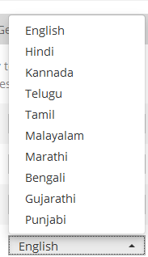
Minimum requirements for online account opening process:
Try our demo video for Online account opening .
1. Keep below documents ready
  a) Photo id proof ( png/jpg )
  - passport
  - Voters id
  - Adhaar card
  ** You will be asked to upload a jpg/png version less than 1mb file size.
  b) Adress proof
  - BSNL bill copy
  - Adhaar/Passport/Voters Id/etc
2. Passport size photo
  ** You will be asked to upload a jpg/png version less than 1mb file size.
  3. Once you have filled all these steps you will be asked to take a print
  out of all pages and sign and mail to Geojit adress.
  Sample copy to show the signature positions.
3. Active web cam for IPV verification (optional)
For a personalized online account
opening assistance Request a CALL BACK !
When clicked give
An option to select
language
Request a call back
Will try later
I am Ready to Start

Slide 7
KYC INFORMATION
TRADING & DEMAT ACCOUNT
Identity Details
Address Details
Make life easy for customers
Name:
Father's /Spouse Name:
Gender:
Marital Status:
Date of Birth: (DD/MM/YYYY format to be followed, validation for minor)
Nationality:
Residential Status:
PAN:
Proof of Identity submitted for PAN exempt cases: (name the ids-ADHAAR/V-ID/DL/OTHERS)
Avoid asking users to fill details repeatedly
NEXT
PRINT
UPLOAD PHOTO
UPLOAD SUPPORTING DOC

Slide 8
KYC INFORMATION
TRADING & DEMAT ACCOUNT
Identity Details
Address Details
Address for Correspondence:
City: (mandatory)
PIN Code: (mandatory for India)
State: (mandatory for India)
Country: (mandatory)
Proof of Address to be provided by Applicant.
Permanent Address:
City/Town/Village:
State:
PIN
Country
Contact Details
Telephone:
Telephone [Res]ISD-STD-#
Mobile:(mandatory)
Email (mandatory, only numeric to b avoided)
Declaration:
PRINT
UPLOAD PHOTO
UPLOAD SUPPORTING DOC
BACK
NEXT

Slide 9
KYC INFORMATION
TRADING & DEMAT ACCOUNT
Trading & Demat Account Details
Follow Step ( 1/11)
1.Sole First Holder Details
1.Sole/ First Holder Details
2.Other Details
3.Second Holder Details
1/11
Sole First Holder Details
How to complete this step
4.BANK DETAILS
Name of Trading Account Holder
Name of the First/Sole Holder Demat
SMS facility Required
Have few key pointers for users which will help
Them to complete this page.
5.STANDING INSTRUCTIONS
6.DEPOSITORY ACCOUNT
DETAILS
7.TRADING PREFERANCES
8.Documentary Evidence of
Financial Details for
Derivative Clients
9.DEALINGS THROUGH SUB
BROKERS AND
STOCK BROKERS
10.ADDITIONAL DETAILS
11.NOMINATION
BACK
NEXT

Slide 10
KYC INFORMATION
TRADING & DEMAT ACCOUNT
Trading & Demat Account Details
Need page specific details assisting users
Follow Step ( 2/11)
1.Sole First Holder Details
2.Other Details
2.Other Details
3.Second Holder Details
2/11
4.BANK DETAILS
Other details
5.STANDING INSTRUCTIONS
Gross Annual Income, pls select the Income Range :
Networth as on [DD] [MM] [YY]
Occupation: Private Sector/ Public Sector/ Govt Service/ etc…
Please Select if applicable: Politically Exposed Person (PEP)/ Related to Politically Exposed Person
Are you a US Person? Y/N
Name of Employer/ Establishment
Designation
6.DEPOSITORY ACCOUNT
DETAILS
7.TRADING PREFERANCES
8.Documentary Evidence of
Financial Details for
Derivative Clients
9.DEALINGS THROUGH SUB
BROKERS AND
STOCK BROKERS
10.ADDITIONAL DETAILS
11.NOMINATION
BACK
NEXT

Slide 11
KYC INFORMATION
TRADING & DEMAT ACCOUNT
Trading & Demat Account Details
I /We request you to open the following Accounts in my/our name as per the following details:
Please select: Trading Account and NSDL Demat Account/Trading Account and CDSL Demat Account/NSDL Demat Account Only/CDSL Demat Account Only
Select the Type of Account: Ordinary Resident/NRI Repatriable/NRI Non Repatriable
Follow Step ( 3/11)
1.Sole First Holder Details
3.Second Holder Details
2.Other Details
3.Second Holder Details
3/11
Second Holder Details
4.BANK DETAILS
Name of the Second Holder:
PAN:
Other Details
Gross Annual Income, pls select the Income Range
Networth
Occupation: Private Sector/ Public Sector/ Govt Service/ etc…
Please Select if applicable: Politically Exposed Person (PEP)/ Related to Politically Exposed Person
Are you a US Person? Y/N
Name of Employer/ Establishment
Designation
5.STANDING INSTRUCTIONS
6.DEPOSITORY ACCOUNT
DETAILS
7.TRADING PREFERANCES
8.Documentary Evidence of
Financial Details for
Derivative Clients
9.DEALINGS THROUGH SUB
BROKERS AND
STOCK BROKERS
10.ADDITIONAL DETAILS
BACK
NEXT
11.NOMINATION

Slide 12
KYC INFORMATION
TRADING & DEMAT ACCOUNT
Trading & Demat Account Details
Follow Step ( 4/11)
1.Sole First Holder Details
4. Bank Details
2.Other Details
3.Second Holder Details
4/11
4.BANK DETAILS
BANK DETAILS
5.STANDING INSTRUCTIONS
6.DEPOSITORY ACCOUNT
DETAILS
Bank Account Number
Account Type (drop down)
Bank Name
Bank Branch Address (format validation i.e street, area, city)
PIN Code (format validation)
IFSC Code (format validation)
MICR (format validation)
RBI Ref No.
RBI Approval Date
7.TRADING PREFERANCES
8.Documentary Evidence of
Financial Details for
Derivative Clients
9.DEALINGS THROUGH SUB
BROKERS AND
STOCK BROKERS
BACK
NEXT
10.ADDITIONAL DETAILS
11.NOMINATION

Slide 13
KYC INFORMATION
TRADING & DEMAT ACCOUNT
Follow Step ( 5/11)
1.Sole First Holder Details
5.STANDING INSTRUCTIONS
2.Other Details
3.Second Holder Details
5/11
4.BANK DETAILS
STANDING INSTRUCTIONS
5.STANDING INSTRUCTIONS
6.DEPOSITORY ACCOUNT
DETAILS
I/We authorise you to receive credits automatically into my/our account [Y/N]
Account to be operated through Power of Attorney (POA) [Y/N] Download of Email ID to Issuer/R&T Agent [Y/N]
I/We authorise you to send all communication/statements through the e-mail only [Y/N] (by default Y-modify the sentence )
Address for Communication/Corporate Benefits : Local/Permanent Addres/ Correspondece/Foreign Address( give option as per booklet)
7.TRADING PREFERANCES
8.Documentary Evidence of
Financial Details for
Derivative Clients
9.DEALINGS THROUGH SUB
BROKERS AND
STOCK BROKERS
10.ADDITIONAL DETAILS
11.NOMINATION
BACK
NEXT

Slide 14
KYC INFORMATION
TRADING & DEMAT ACCOUNT
Follow Step ( 6/11)
1.Sole First Holder Details
6.Depository Acc Details( populate depending type selected)
2.Other Details
3.Second Holder Details
6/11
4.BANK DETAILS
DEPOSITORY ACCOUNT DETAILS
5.STANDING INSTRUCTIONS
Depository Participant Name
Depository Name
Beneficiary Name
DP ID
Beneficiary ID
6.DEPOSITORY ACCOUNT
DETAILS
7.TRADING PREFERANCES
8.Documentary Evidence of
Financial Details for
Derivative Clients
9.DEALINGS THROUGH SUB
BROKERS AND
STOCK BROKERS
10.ADDITIONAL DETAILS
11.NOMINATION
BACK
NEXT

Slide 15



KYC INFORMATION
TRADING & DEMAT ACCOUNT
Trading & Demat Account Details
I /We request you to open the following Accounts in my/our name as per the following details:
Please select: Trading Account and NSDL Demat Account/Trading Account and CDSL Demat Account/NSDL Demat Account Only/CDSL Demat Account Only
Select the Type of Account: Ordinary Resident/NRI Repatriable/NRI Non Repatriable
Follow Step ( 7/11)
1.Sole First Holder Details
7.TRADING PREFERANCES
2.Other Details
3.Second Holder Details
7/12
TRADING PREFERENCES
4.BANK DETAILS
5.STANDING INSTRUCTIONS
6.DEPOSITORY ACCOUNT
DETAILS
NSE
BSE
Cash Market
7.TRADING PREFERANCES
8.Documentary Evidence of
Financial Details for
Derivative Clients
F&O
F&O
9.DEALINGS THROUGH SUB
BROKERS AND
STOCK BROKERS
10.ADDITIONAL DETAILS
11.NOMINATION
BACK
NEXT

Slide 16
KYC INFORMATION
TRADING & DEMAT ACCOUNT
Follow Step ( 8/11)
1.Sole First Holder Details
8.Documentary Evidence of Financial Details for Derivative Clients
2.Other Details
3.Second Holder Details
8/12
4.BANK DETAILS
Copy of Tax Return
5.STANDING INSTRUCTIONS
6.DEPOSITORY ACCOUNT
DETAILS
Salary Certificate
Net Worth Certificate
7.TRADING PREFERANCES
8.Documentary Evidence of
Financial Details for
Derivative Clients
Bank Statement for the last 6 months
Others, Please specify
9.DEALINGS THROUGH SUB
BROKERS AND
STOCK BROKERS
Upload functionality
10.ADDITIONAL DETAILS
11.NOMINATION
BACK
NEXT

Slide 17
KYC INFORMATION
TRADING & DEMAT ACCOUNT
Follow Step ( 9/11)
1.Sole First Holder Details
9.DEALINGS THROUGH SUB
BROKERS AND STOCK BROKERS
2.Other Details
3.Second Holder Details
9/11
4.BANK DETAILS
5.STANDING INSTRUCTIONS
6.DEPOSITORY ACCOUNT
DETAILS
DEALINGS THROUGH SUB BROKERS AND STOCK BROKERS
7.TRADING PREFERANCES
8.Documentary Evidence of
Financial Details for
Derivative Clients
Are you dealing through any Sub broker? [Y/N]
If yes
Sub Broker Name
NSE SEBI Reg No
BSE SEBI Reg No
Regd Office Address
Phone
Fax
Web site
Are you dealing through any Broker?
If yes Name of the Broker
Name of Sub broker
Client Code
Exchange
Details of disputes/dues pending from/to such stock broker sub broker
9.DEALINGS THROUGH SUB
BROKERS AND
STOCK BROKERS
10.ADDITIONAL DETAILS
11.NOMINATION
BACK
NEXT

Slide 18
KYC INFORMATION
TRADING & DEMAT ACCOUNT
Follow Step ( 10/11)
1.Sole First Holder Details
10.ADDITIONAL DETAILS
2.Other Details
3.Second Holder Details
10/11
4.BANK DETAILS
5.STANDING INSTRUCTIONS
6.DEPOSITORY ACCOUNT
DETAILS
ADDITIONAL DETAILS
7.TRADING PREFERANCES
Whose Mobile number is used (please select the relationship) ?
[SELF/SPOUSE/Dependent Parent/Dependant Child]
Are you a relative of Geojit BNP Paribas Employees [Y/N]
Relationship
Employee Name
Employee Code
8.Documentary Evidence of
Financial Details for
Derivative Clients
Whether you wish to receive Electronic or Physical Contract Notes? Electronics ECN/Physical
Whether you wish to avail the facility of Internet Trading [Y/N]
Number of years Investment / Trading Experience [1,2,3…7]
SMS and Email Alert to Investors by Stock Exchanges (Please select) [SMS/EMAIL/BOTH/NOT REQUIRED]
9.DEALINGS THROUGH SUB
BROKERS AND
STOCK BROKERS
10.ADDITIONAL DETAILS
11.NOMINATION
BACK
NEXT

Slide 19
KYC INFORMATION
TRADING & DEMAT ACCOUNT
Follow Step ( 11/11)
1.Sole First Holder Details
11.NOMINATION
2.Other Details
3.Second Holder Details
11/11
Nomination Required YES/NO
IF YES
Name of Nominee
Relationship
Contact Details
Telephone Number(office)
Telephone Number(residence)
Fax No.
Mobile Number
Email ID
UPLOAD PHOTOGRAPH OF NOMINEE
4.BANK DETAILS
5.STANDING INSTRUCTIONS
6.DEPOSITORY ACCOUNT
DETAILS
Address of Nominee
City/Town/Village
Pincode
State
Country
7.TRADING PREFERANCES
8.Documentary Evidence of
Financial Details for
Derivative Clients
Savings bank account number
Date of Birth
Demat account details of nominee
DP ID
Client ID
9.DEALINGS THROUGH SUB
BROKERS AND
STOCK BROKERS
PAN of nominee
Adhar number of nominee
10.ADDITIONAL DETAILS
11.NOMINATION
(continued in next slide)

Slide 20
(continued from slide 16)
Date of Birth in case of minor nominee
Name of Guardian
Relationship with Guardian
Address of Guardian
City/Town/Village
Pincode
State
Country
Contact Details of Guardian
Telephone Number(office)
Telephone Number(residence)
Fax No.
Mobile Number
Email ID
UPLOAD PHOTOGRAPH OF Guardian
Savings bank account number of guardian
PAN of nominee of Guardian
Copy of any proof of identity document (accompanied by
original for verification or duly attested by any entity authorized
for attesting the documents, as provided in Annexure JB )
Adhar number of Guardian
Demat account details of guardian
DP ID
Client ID
Name and signature of account holders
Sole/First Holder
Second Holder
Third Holder
Signature of witness for nomination
Name of Witness
Address
Signature of Witness

Slide 21
DECLARATION
Declaration content here

Slide 22
Upload documents
Below provide the required documents as part of account opening details
1. PAN CARD
UPLOAD A COPY

Slide 23
Preview uploaded documents
Below provide the required documents as part of account opening details
1. PAN CARD
RE-UPLOAD A COPY
2. ADDRESS PROOF
RE-UPLOAD A COPY

Slide 24
You have Successfully completed the online steps
What you can do next ?
A copy of the link is mailed to check the status.
Reference #: GBN12345
Once data is verified you will receive an email to download
the documents in 24hrs.
Address to courier the signed application form
New Customer Cell
Geojit BNP Paribas
34/659-P, Civil Line Road Padivattom, Kochi 682024
customercare @geojit.com
+91.0484-2901000
REQUEST A PRINTED BOOKLET
2.Option to received printed booklet via courier
BACK
NEXT

